Slide 1
Mongo DB with PHP and Java
James Xue, Zainab Al-Waisi

Slide 2
MongoDB Drivers
One wire protocol for all client languages
A driver implementation per language
Responsibilities:
Converting language dependent data structure <->BSON
Generating ObjectId for _id field.

Slide 3
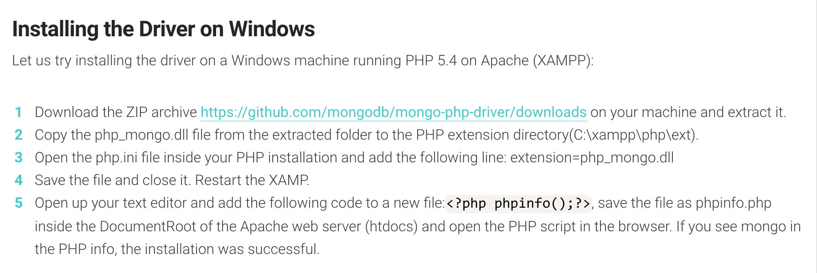
Install MongoDB Driver on Windows

Slide 4


Install MongoDB with PHP on MAMP on Mac
Install Homebrew:
Install MongoDB
Install PHP MongoDB Driver
Edit php.ini
Add extension=mongo.so to php.ini
Retart MAMP
Ref: http://lukepeters.me/blog/setting-up-mongodb-with-php-and-mamp

Slide 5


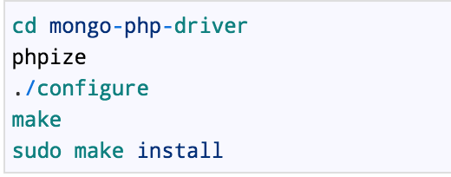


Install MongoDB on CentOS
Prepare the tools to build PHP extensions
Get the latest MongoDB PHP driver source code
Build the driver
Edit the php.ini file
Restart Apache web server
Ref: https://madcoda.com/2012/12/install-mongodb-php-driver-in-centos-6-3/

Slide 6
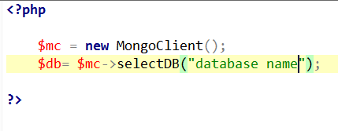
Database Connection
Add the following lines (dbconnection.php) to connect to MongoDB from PHP:
Some older drivers use Mongo, which is deprecated.

Slide 7
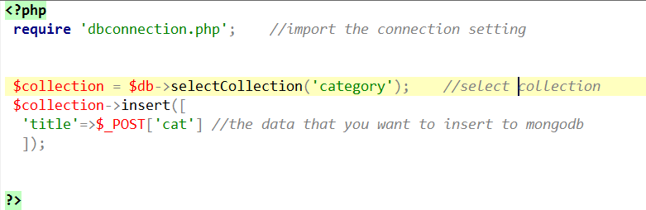
CRUD – INSERT

Slide 8
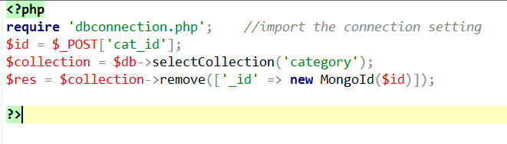
CRUD – DELETE
Or simply $collection = $db->category;

Slide 9
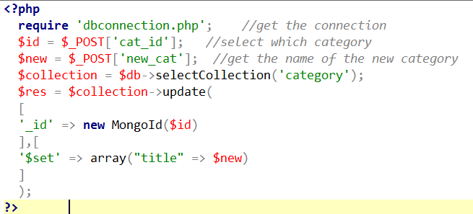
CRUD – UPDATE

Slide 10
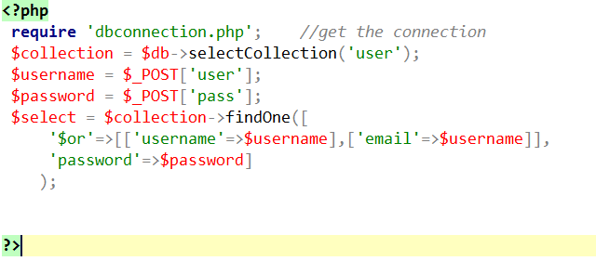
CRUD – READ/DISPLAY

Slide 11
Building a Simple Blog App with MongoDB and PHP
https://www.sitepoint.com/building-simple-blog-app-mongodb-php/

Slide 12
MongoDB Java Driver Features
CRUD
Support for replica sets
Connection pooling
Distributed reads to slave servers
BSON serialisation/deserialisation
JSON serialisation/deserialisation
GridFS

Slide 13
Create a project in IDE
Download the driver: mongo-java-driver-VERSION.jar
Create a project using your favorate IDE
Add the .jar file as external library

Slide 14
Create a Maven project using command line
Type the following command (ensure maven is installed)
mvn archetype:generate -DgroupId=uk.ac.northampton - DartifactId=mongodb -DarchetypeArtifactId=maven-archetype- quickstart -DinteractiveMode=false
cd my_app
add maven dependency of mongodb driver in the pom.xml file as in the next slide.

Slide 15
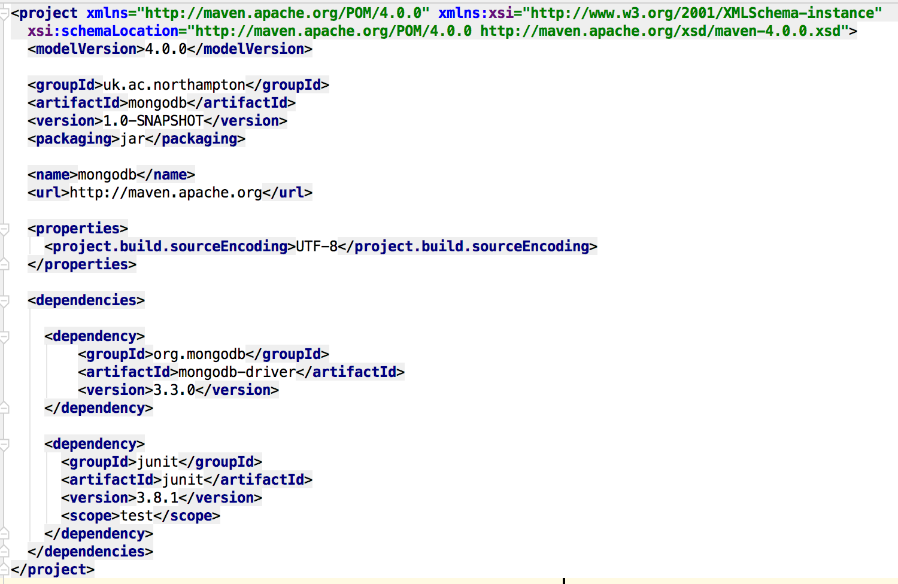
Maven Dependency in pom.xml

Slide 16
MongoDB Maven Project
mvn idea:idea (if you are using Intellij IDEA)
OR mvn eclipse:eclipse
Open my_app.ipr

Slide 17
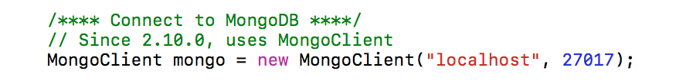
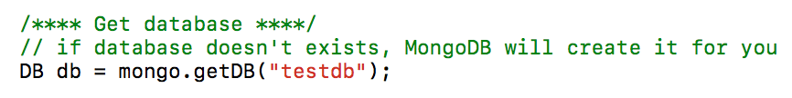
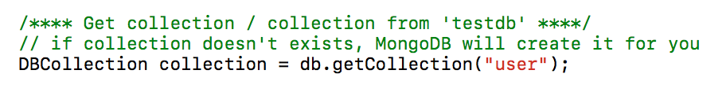
Database Connection

Slide 18
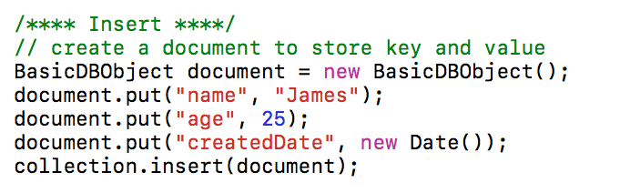
CRUD – CREATE

Slide 19
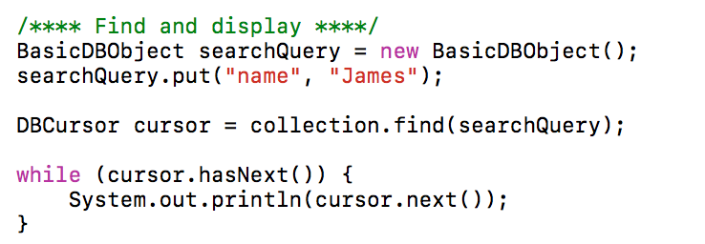
CRUD – READ

Slide 20
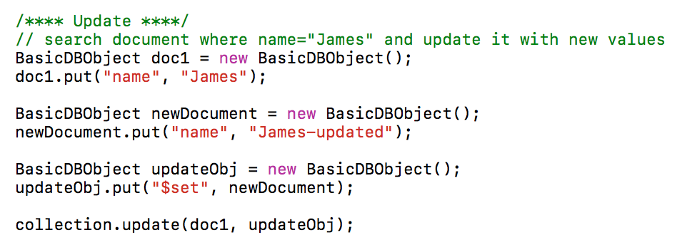
CRUD - UPDATE

Slide 21
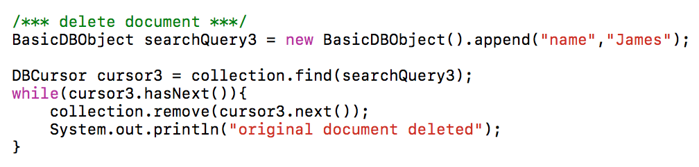
CRUD – DELETE

Slide 22
Demo

